Slide 1
Background

Slide 2
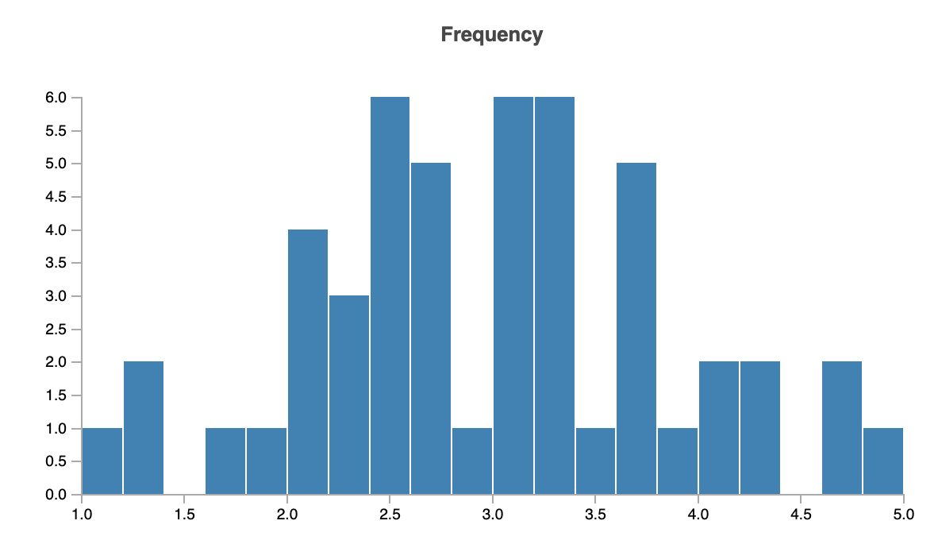
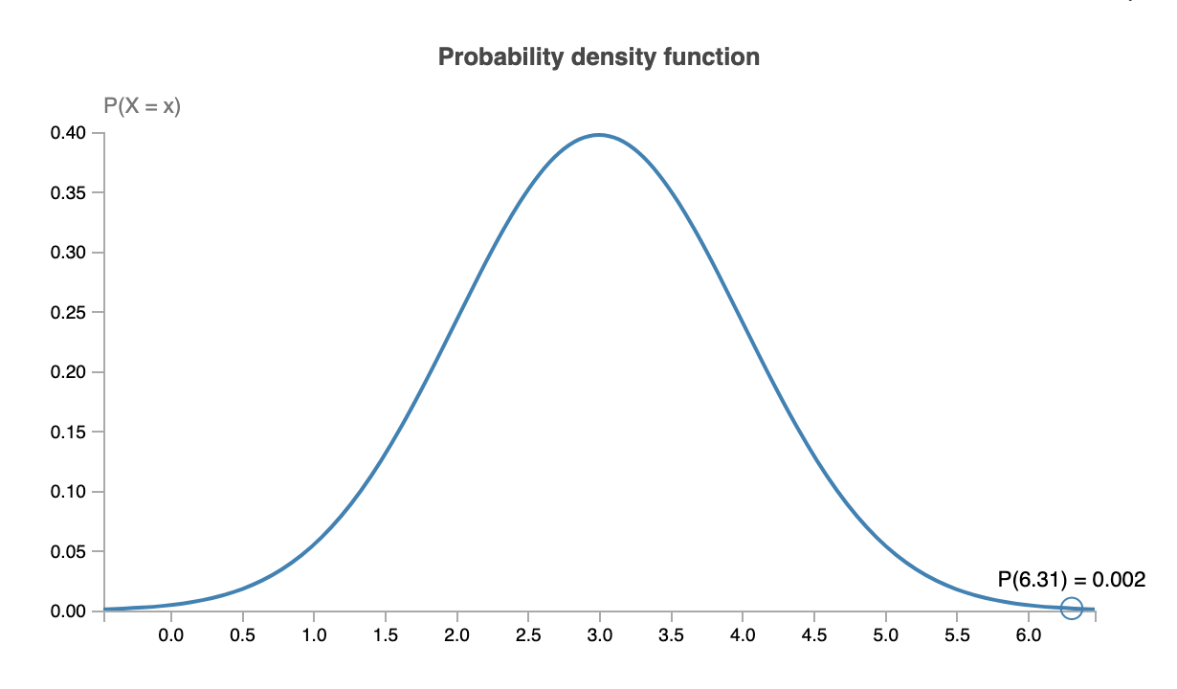





Statistic vs. Parameter
Sample
Population
Sample statistic
Known but random
Population parameter
Unknown but fixed
Estimator

Slide 3

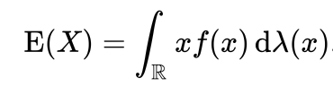
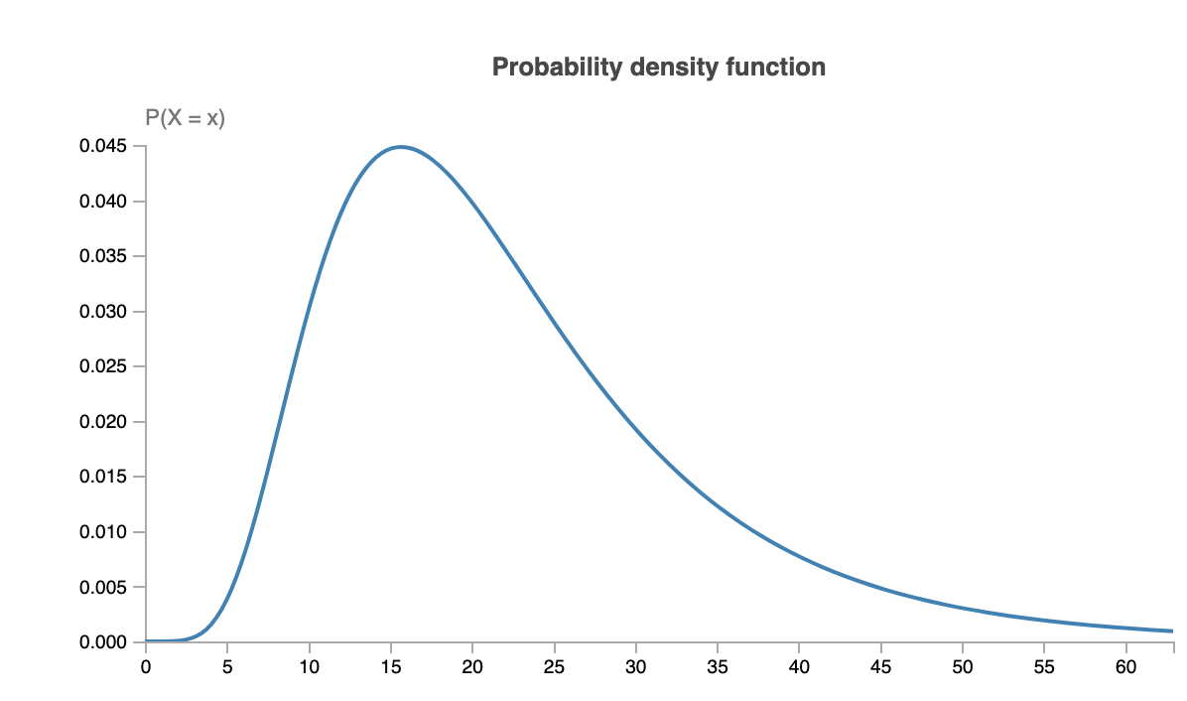
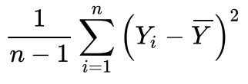
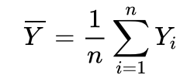

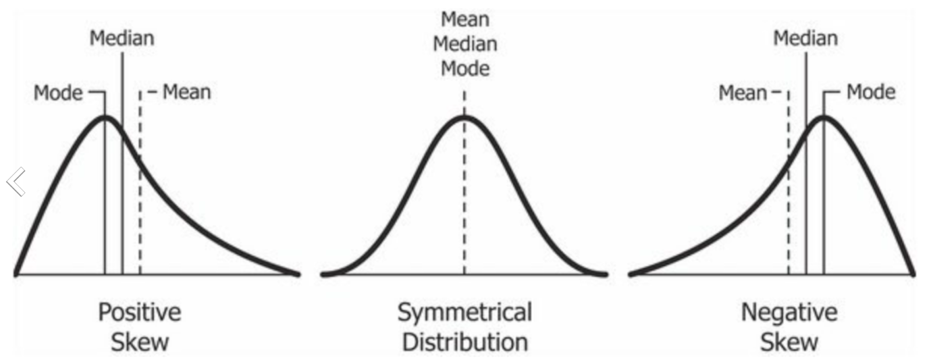
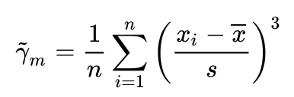
Common parameters/statistics
Sample
Mean: average
Mode: Most frequent outcome
Median: “splits sample in two halves”
(Unbiased/biased) variance:
Estimator for skewness:
Population
Expectation value/mean: “weighted average”
Mode: Extreme value of density function
Median: “splits population in two halves”
Variance: expected deviation from mean
Skewness: Symmetry of the density function

Slide 4
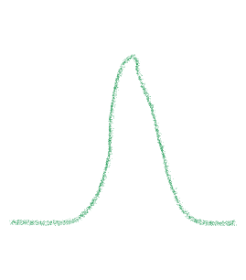
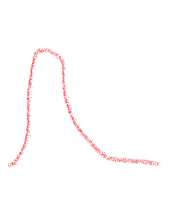
Sampling distribution
Sample
Population
Sample statistic
Known but random
Population parameter
Unknown but fixed
Estimator

Slide 5
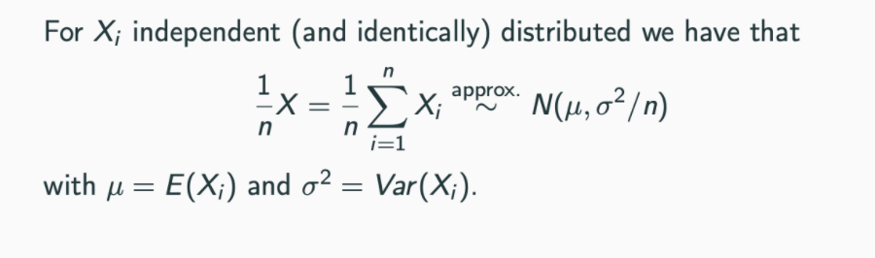
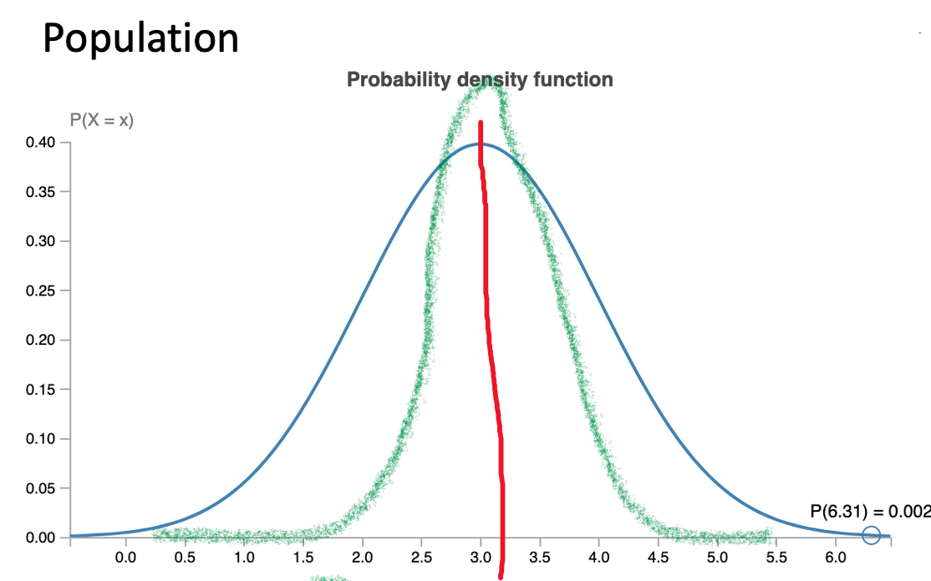
Central limit theorem
If our sample size is big enough, the mean of the underlying distribution is likely to be close to our sample mean.

Slide 6
Play with distributions
https://www.essycode.com/distribution-viewer/

Slide 7
Statistical testing

Slide 8




Can you trust your brother?
I do not trick you
Can I really trust him?
Head
Tail
Head
Head
Head
P(Head Head Head | He does not trick me) = 0.5^3=12.5%
>=
 | P(Head) <= 0.5 | P(Head) > 5
trust | correct | error
mistrust | error | correct
< 5%

Slide 9



Can you trust your brother?
 | P(Head) <= 0.5 | P(Head) > 0.5
trust | correct | error
mistrust | error | correct
<= 5%
Wait until day 10
Count number of Heads (H)
If H > K -> mistrust, else trust
How to choose K?

Slide 10
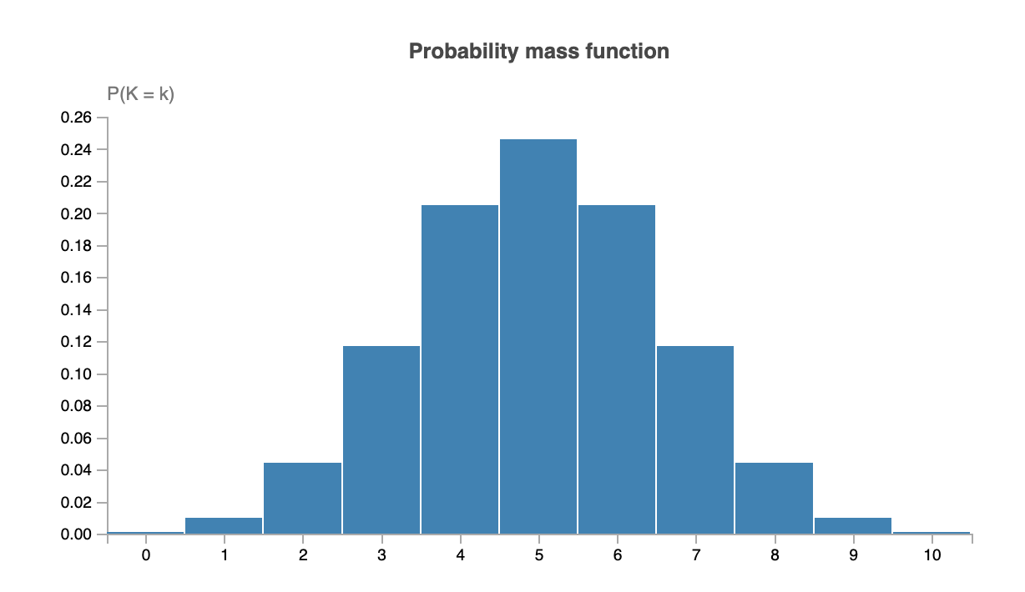
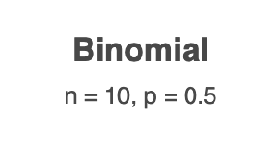








Can you trust your brother?
 | P(Head) <= 0.5 | P(Head) > 0.5
trust | correct | error
mistrust | error | correct
<= 5%
H ~ Bin(10,P(Head))
P=0.055
P=0.01
P=0.00098

Slide 11









Can you trust your brother?
I don’t trick you
I mistrust if K > 8
Can I really trust him?
Head
Tail
Head Head Head Head Tail Head Head Head Head Head
 | Fair | Not fair
trust | correct | error
mistrust | error | correct
<= 5%
<= 1%
P=0.01

Slide 12


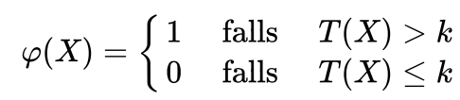
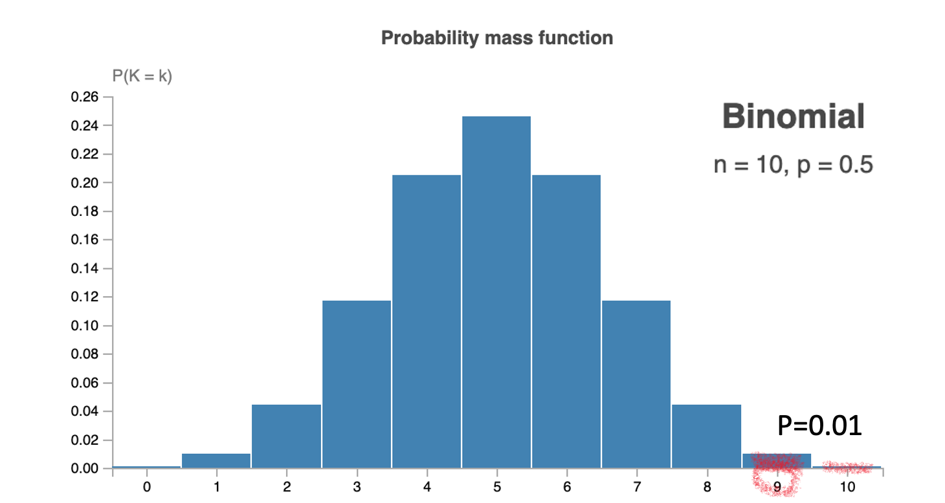






Hypothesis Test
 | P(Head) <= 0.5 | P(Head) > 0.5
trust | correct | error
mistrust | error | correct
H₀
H₁
Not reject H₀
Specificity (1-𝛼)
Type II error ($β)$
Reject H₀
Type I error $(α)$
Sensitivity/Power (1- $β$)
Significance level $α$
<= 5%
Wait until day 10
Count number of Heads (H)
If H >= K -> mistrust, else trust
Sample
Test statistic
Critical value
P-value

Slide 13
Type of tests

Slide 14
Study design/Question
Types of data
Categorical
Discrete
Continuous
…
Two sample
Two groups are observed
(How) do the distributions differ?
One sample
One group is observed
What can we say about the distribution?
Dependent
Outcome of the samples influence each other
„Paired dependence“
Independent
Outcome of the samples do not influence each other
One sided
We want to prove that sth is greater or smaller than sth else
If there is a difference, we know in which direction it will be
Two sided
We want to prove that two things are different
Not sure in which direction the difference will be

Slide 15
Parametric vs. non parametric test
Parametric test
Assumptions about the underlying distribution
“More statistical power”
Non parametric
No assumption about the underlying distribution
Safer choice
How to decide?
Visual check -> Plot and compare
Compute sample/distribution statistics
Test ☺

Slide 16
Assumptions on the variance
One sample
Variance known
Variance unknown
Two sample
same, known variance
same, unknown variance
different variance
How to decide?
Visual check -> Plot and compare
Test ☺

Slide 17
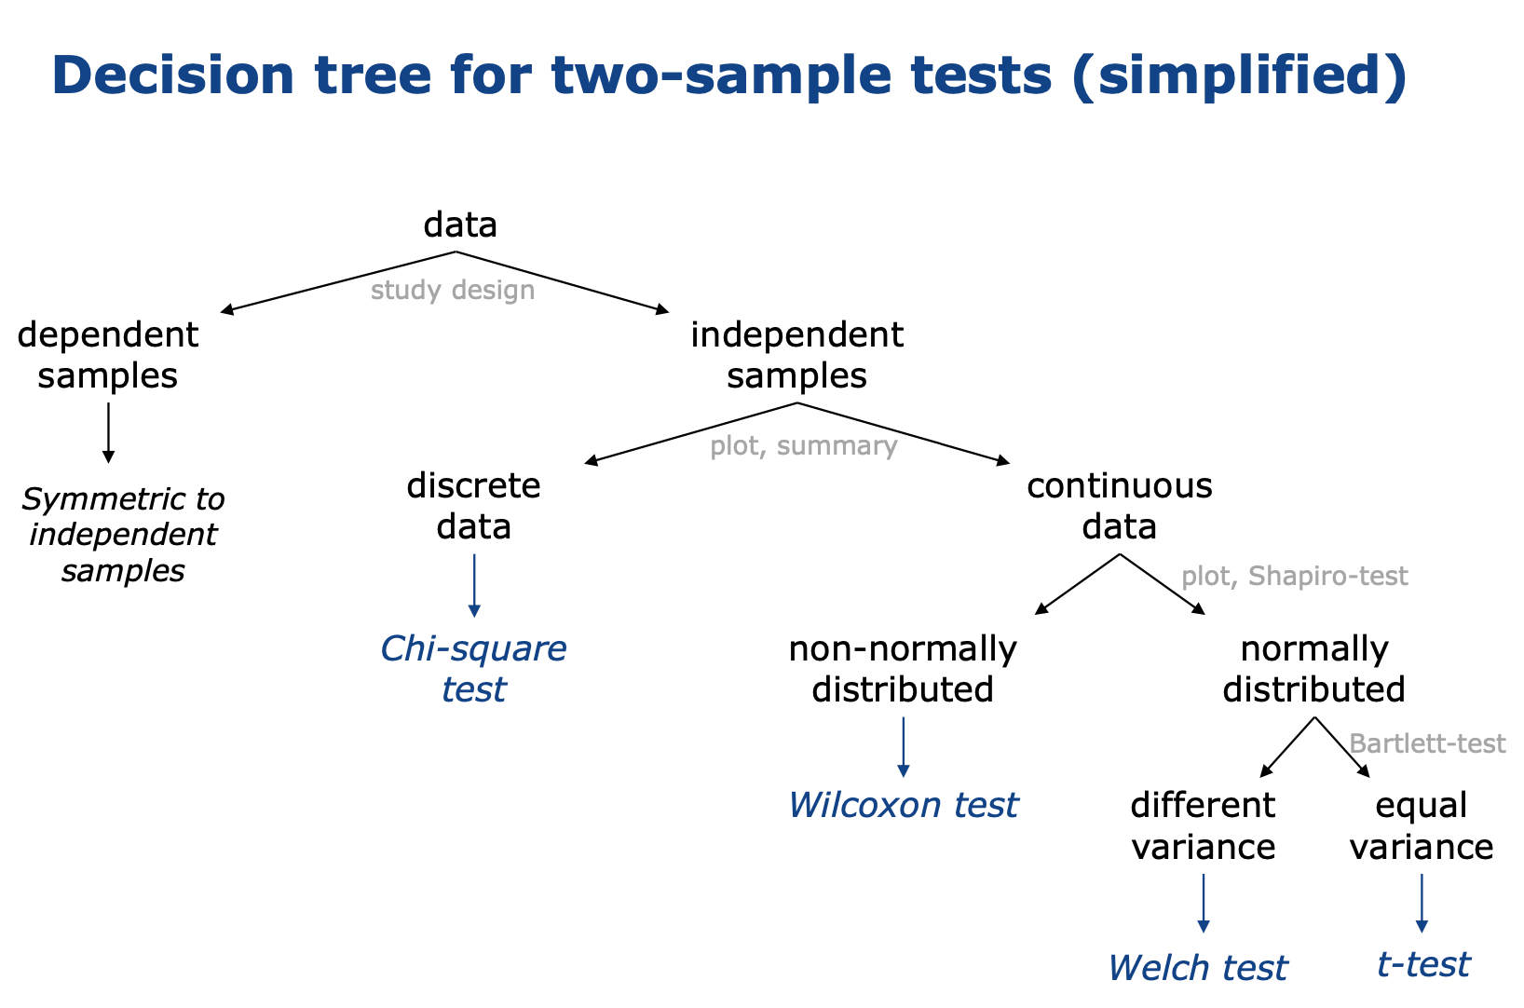


paired

Slide 18
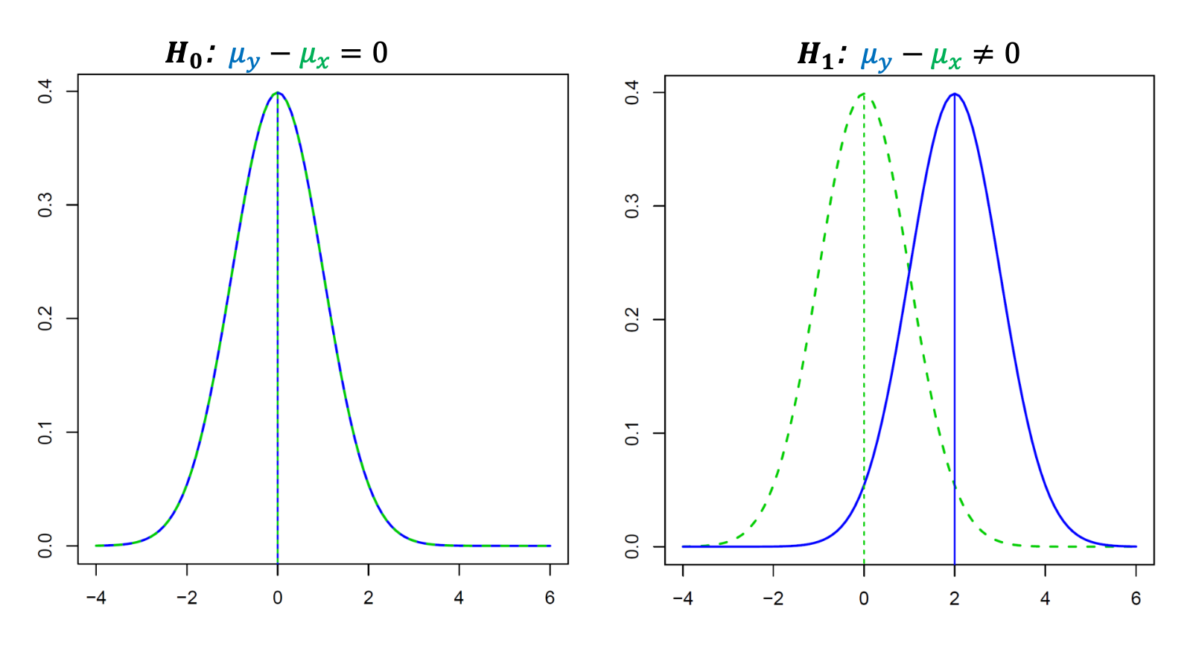
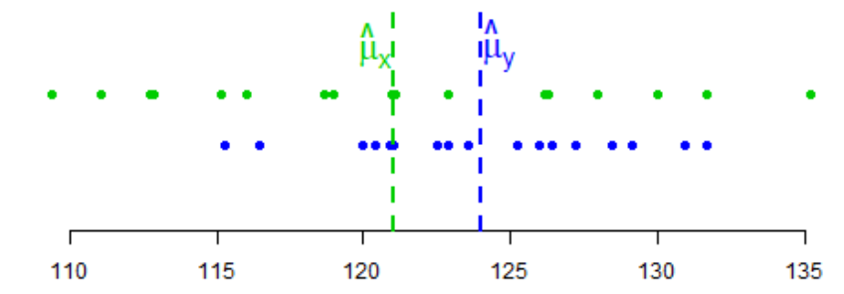



Example: “t-test”
Two groups X, Y -> Do they, on average, differ?
H₀: mean(X) = mean(Y) vs. H₁: mean(X) $≠$ mean(Y)
Assumptions: $X \sim 𝒩\left(μ_{X}, σ^{2}\right), Y\sim 𝒩\left(μ_{Y}, σ^{2}\right)$ or sample size large enough
Significance level: 5%
H₀: $μ_{X}−μ_{Y}=0$vs. H₁: $μ_{X}−μ_{Y}≠0$
Sample

Slide 19
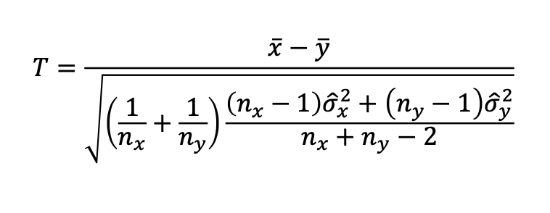
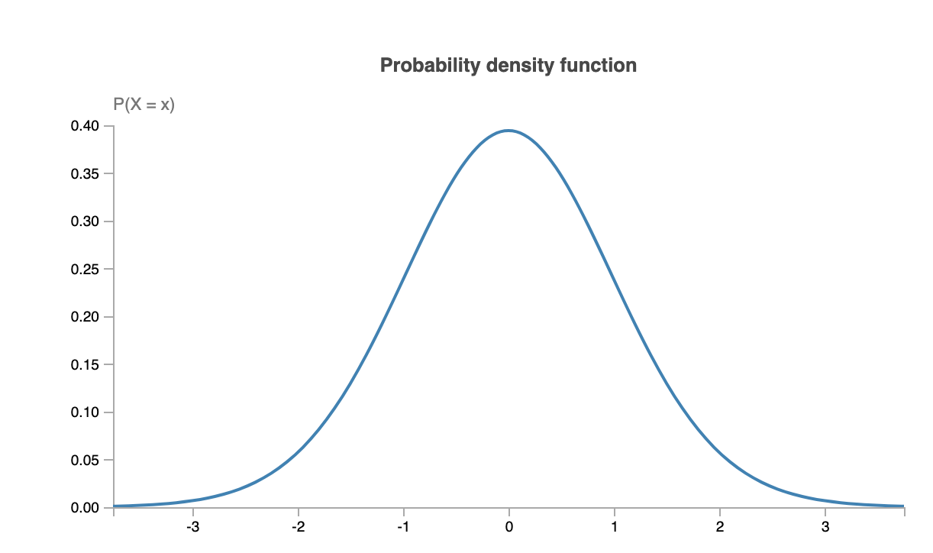
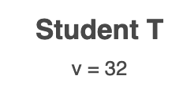
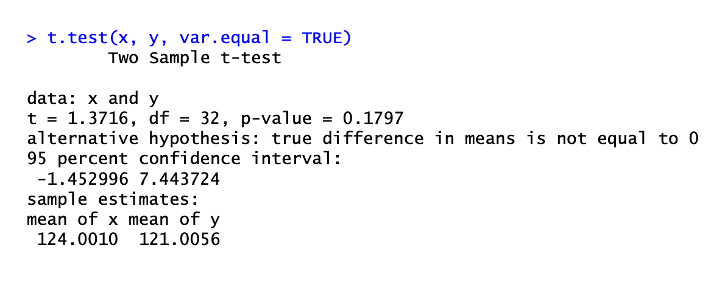







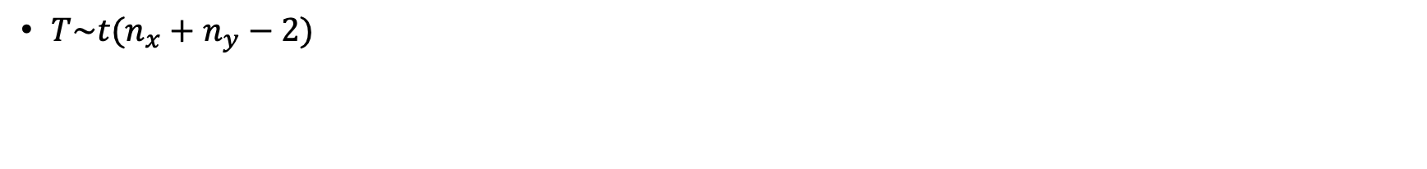





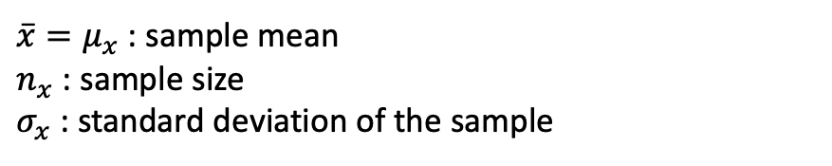









Example: “t-test”
$\overline{x}=μ_{x}$ : sample mean
$n_{x}$ : sample size
$σ_{x}$ : standard deviation of the sample
Test statistic
$T\sim t(n_{x}+n_{y}−2)$
Students t distribution

Slide 20
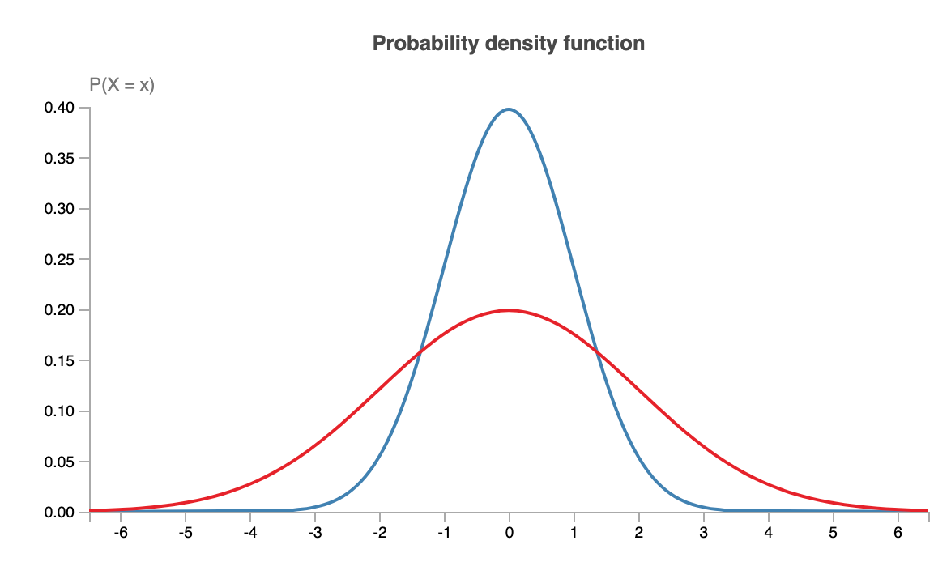
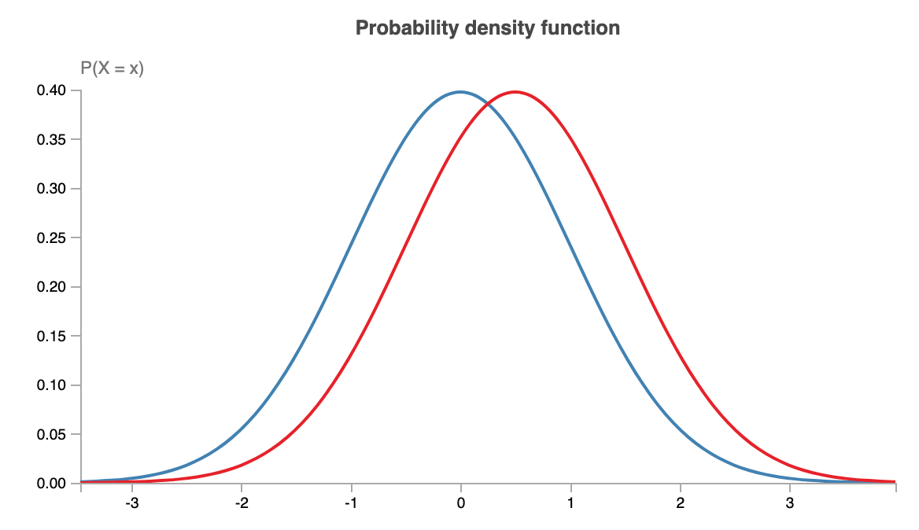



T-test not possible
median(X) = median(Y)
Ranksum/Whitney-U-Tests: $X\sim Y$?
Kolgmogorov-Smirnov-Test: $X\sim Y$?

Slide 21
Multiple Testing problem

Slide 22
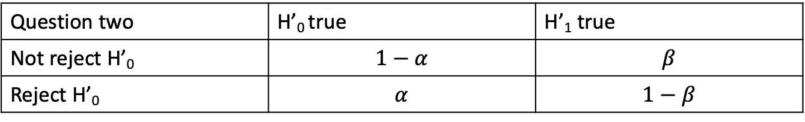

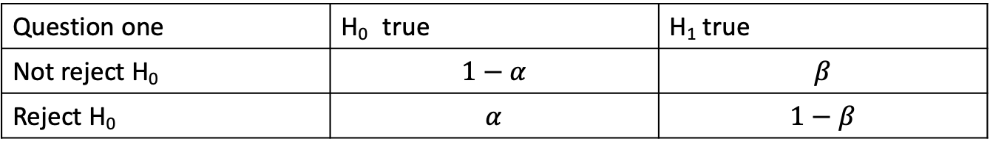

Multiple Testing Problem
Question one | H₀ true | H₁ true
Not reject H₀ | $$1−α$$ | $$β$$
Reject H₀ | $$α$$ | $$1−β$$
Question two | H’₀ true | H’₁ true
Not reject H’₀ | $$1−α$$ | $$β$$
Reject H’₀ | $$α$$ | $$1−β$$
-> “Prove” that H₁ is correct with significance level $α$ and that H’₁ is correct with significance level $α$
NOT: “Prove” that H₁ and H’₂ are both correct (at the same time) with significance level $α$
H₁
H’₁
H₁
H’₁
versus
H₁
H’₁
H₁
H’₁

Slide 23


Multiple Testing Problem
Question one | H₀ true | H₁ true
Not reject H₀ | $$1−α$$ | $$β$$
Reject H₀ | $$α$$ | $$1−β$$
Question two | H’₀ true | H’₁ true
Not reject H’₀ | $$1−α$$ | $$β$$
Reject H’₀ | $$α$$ | $$1−β$$
-> “Prove” that H₁ is correct with significance level $α$ and that H’₁ is correct with significance level $α$
NOT: “Prove” that H₁ and H’₂ are both correct (at the same time) with significance level $α$

Slide 24
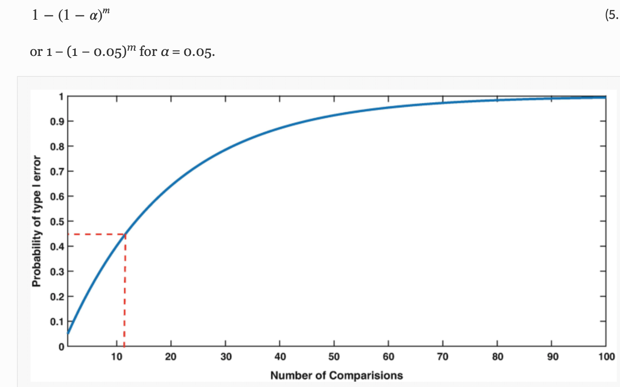



Multiple Testing Problem
Assumes independence -> pessimistic
One sample, two Questions
Question one | H₀ true | H₁ true
Not reject H₀ | $$1−α$$ | $$β$$
Reject H₀ | $$α$$ | $$1−β$$
Question two | H’₀ true | H’₁ true
Not reject H’₀ | $$1−α$$ | $$β$$
Reject H’₀ | $$α$$ | $$1−β$$
Probability for making no false alarm for each test: 0.95
-> ass. independent: risk of both no false alarm: 0.95*0.95 = 0.9
-> risk of any false alarm: 1 - 0.9 = 0.1

Slide 25
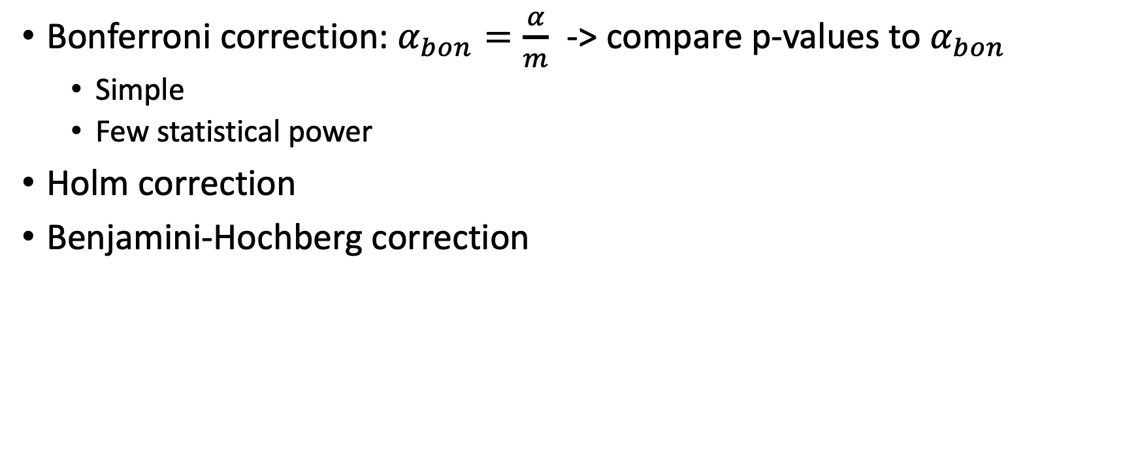
Multiple Testing Problem
Bonferroni correction: $α_{bon}=\frac{α}{m}$ -> compare p-values to $α_{bon}$
Simple
Few statistical power
Holm correction
Benjamini-Hochberg correction

Slide 26
Regression example
Y = aX + b + err
Does it follow normal dist?
Is it significant?

Slide 27
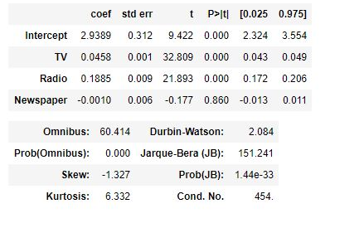
Regression table
Sales ~ TV + Radio + Newspaper

